Slide 1
NORMALIZATION
Dr. Sanjeev Kumar
Asst. Professor

Slide 2
Objective
Database Normalization is a technique of organizing the data in the database.
Normalization is a systematic approach of decomposing tables to eliminate data redundancy(repetition) and undesirable characteristics like Insertion, Update and Deletion Anomalies.
It is a multi-step process that puts data into tabular form, removing duplicated data from the relation tables.

Slide 3

Example Insert Anomalies
SSN | NAME | FNAME | SALARY | ADDRESS | DNO | DNAME
1001 | AMIT | MANOJ | 62000 | MATHURA | 10 | CS
1002 | SUMIT | ABHISHEK | 54000 | AGRA | 20 | CE
1003 | JAY | KRISHNA | 55000 | KANPUR | 10 | CS
1004 | RADHA | RAJ KUMAR | 40000 | AGRA | 30 | ME
1005 | PRIYANSHU | ANIMESH | 50000 | DELHI | 20 | CE
1006 | JOY | AKASH | 60000 | BAREILLY | 10 | CS
1007 | AMIT | PRATEEK | 50000 | LUCKNOW | 10 | CS
PROBLEM IN INSERTION
SUPPOSE WANT TO ADD ONE MORE DEPARTMENT 40 EE

Slide 4
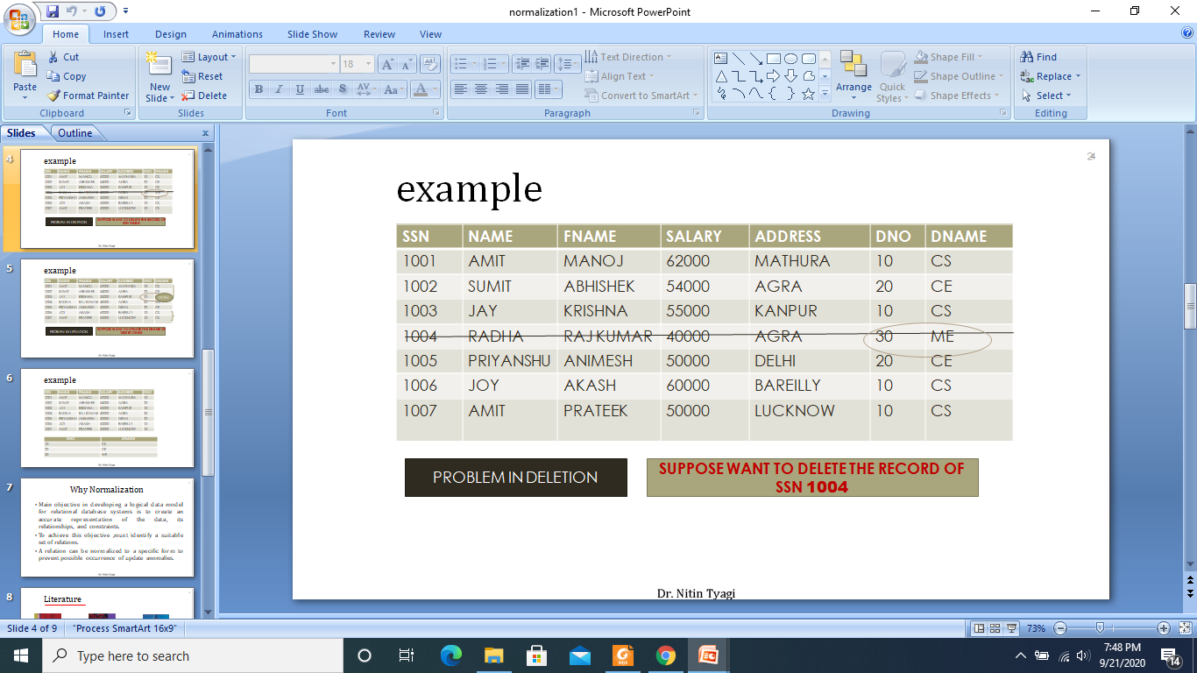
Delete Anomalies

Slide 5
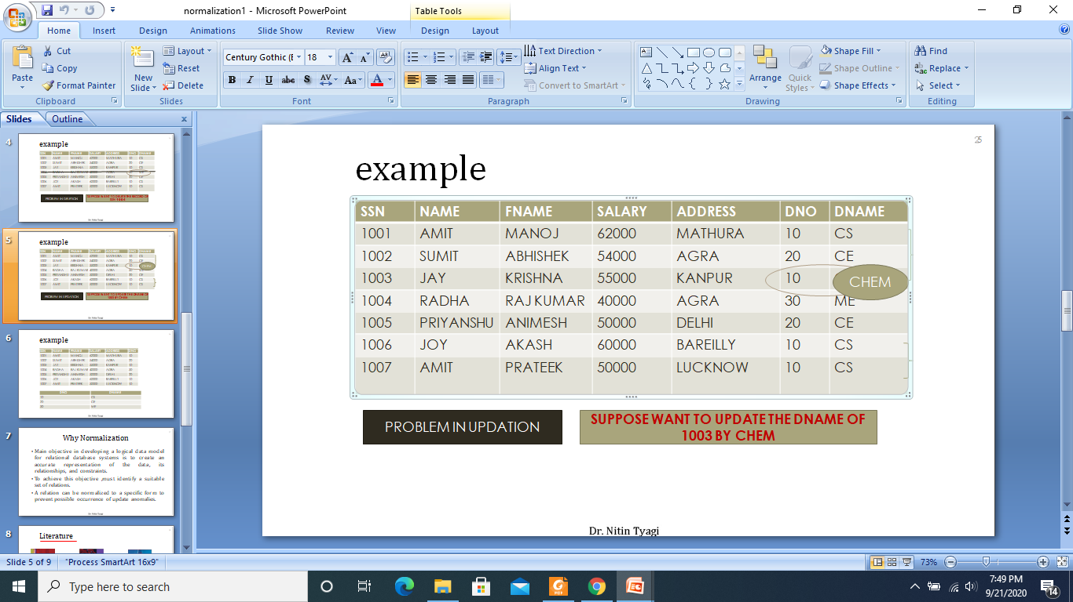
Update Anomalies

Slide 6
Levels of Normalization
Levels of normalization based on the amount of redundancy in the database.
Various levels of normalization are:
  First Normal Form (1NF)
  Second Normal Form (2NF)
  Third Normal Form (3NF)
  Boyce-Codd Normal Form (BCNF)
  Fourth Normal Form (4NF)
  Fifth Normal Form (5NF)
  Domain Key Normal Form (DKNF)
Redundancy
Number of Tables
Complexity
Most databases should be 3NF or BCNF in order to avoid the database anomalies.

Slide 7
Levels of Normalization
1NF
2NF
3NF
4NF
5NF
DKNF
Each higher level is a subset of the lower level

Slide 8
First Normal From
A table is in the first normal form iff
  The domain of each attribute contains only atomic values, and
  The value of each attribute contains only a single value from that domain.
In layman's terms. it means every column of
your table should only contain single values

Slide 9
Example
For a library
Patron ID | Borrowed books
C45 | B33, B44, B55
C12 | B56

Slide 10
Armstrong inference rules (1974)
Axioms are both
  Sound:
  when applied to a set of functional dependencies they only produce dependency tables that belong to the transitive closure of that set
  Complete:
  can produce all dependency tables that belong to the transitive closure of the set

Slide 11
1-NF Solution
Patron ID | Borrowed book
C45 | B33
C45 | B44
C45 | B33
C12 | B56

Slide 12
Example
For an airline
Flight | Weekdays
UA59 | Mo We Fr
UA73 | Mo Tu We Th Fr

Slide 13
1NF Solution
Flight | Weekday
UA59 | Mo
UA59 | We
UA59 | Fr
UA73 | Mo
UA73 | We
… | …

Slide 14
Functional Dependencies
The value of one attribute (the determinant) determines the value of another attribute.
A →B reads “Attribute B is functionally dependent on A.
A→B means if two rows have same value of A they necessarily have same value of B
Example 1
ISBN
Title
Price
Table Scheme: {ISBN, Title, Price}
Functional Dependencies: {ISBN} → {Title}
{ISBN} → {Price}
0-321-32132-1
Balloon
$34.00
0-55-123456-9
Main Street
$22.95
0-123-45678-0
Ulysses
$34.00
1-22-233700-0
Visual Basic
$25.00
Notes:
Notes to Instructor: Need more rigor in the functional dependencies. With a few examples. May be create a class assignment for functional dependencies.

Slide 15
Functional Dependencies
Example 2
Table Scheme: {PubID, PubName, PubPhone}
Functional Dependencies: {PubId} → {PubPhone}
{PubId} → {PubName}
{PubName, PubPhone} → {PubID}
PubID
PubName
PubPhone
1
Big House
999-999-9999
2
Small House
123-456-7890
3
Alpha Press
111-111-1111
Example 3
AuID
AuName
AuPhone
Table Scheme: {AuID, AuName, AuPhone}
Functional Dependencies: {AuId} → {AuPhone}
{AuId} → {AuName}
{AuName, AuPhone} → {AuID}
1
Sleepy
321-321-1111
2
Snoopy
232-234-1234
3
Grumpy
665-235-6532
4
Jones
123-333-3333
5
Smith
654-223-3455
6
Joyce
666-666-6666
7
Roman
444-444-4444

Slide 16
Armstrong inference rules (1974)
Axioms:
  Reflexivity: if Y⊆X, then X→Y
  Augmentation: if X→Y, then WX→WY
  Transitivity: if X→Y and Y→Z, then X→Z
Derived Rules:
  Union: if X→Y and X→Z, the X→YZ
  Decomposition: if X→YZ, then X→Y and X→Z
  Pseudotransitivity: if X→Y and WY→Z, then XW→Z

Slide 17
Armstrong inference rules (1974)
Three last rules can be derived from the first three (the axioms)
Let us look at the union rule:
if X→Y and X→Z, the X→YZ
Using the first three axioms, we have:
  if X→Y, then XX→XY same as X→XY (2nd)
  if X→Z, then YX→YZ same as XY→YZ (2nd)
  if X→XY and XY→YZ, then X→YZ (3rd)

Slide 18
Second Normal Form
A table is in 2NF iff
  It is in 1NF and
  no non-prime attribute is dependent on any proper subset of any candidate key of the table(All nonkey attributes in the table must be functionally dependent on the entire primary key)
A non-prime attribute of a table is an attribute that is not a part of any candidate key of the table
A candidate key is a minimal superkey

Slide 19
Example
Library allows patrons to request books that are currently out
BookNo | Patron | PhoneNo
B3 | J. Fisher | 555-1234
B2 | J. Fisher | 555-1234
B2 | M. Amer | 555-4321

Slide 20
Example
Candidate key is {BookNo, Patron}
We have
  Patron → PhoneNo
Table is not 2NF
  Potential for
    Insertion anomalies
    Update anomalies
    Deletion anomalies

Slide 21
2NF Solution
Put telephone number in separate Patron table
BookNo | Patron
B3 | J. Fisher
B2 | J. Fisher
B2 | M. Amer
Patron | PhoneNo
J. Fisher | 555-1234
M. Amer | 555-4321

Slide 22
Second Normal Form (2NF)
Example 2 (Not 2NF)
Scheme → {City, Street, HouseNumber, HouseColor, CityPopulation}
  key → {City, Street, HouseNumber}
  {City, Street, HouseNumber} → {HouseColor}
  {City} → {CityPopulation}
  CityPopulation does not belong to any key.
  CityPopulation is functionally dependent on the City which is a proper subset of the key
Example 3 (Not 2NF)
Scheme → {studio, movie, budget, studio_city}
  Key → {studio, movie}
  {studio, movie} → {budget}
  {studio} → {studio_city}
  studio_city is not a part of a key
  studio_city functionally depends on studio which is a proper subset of the key
Notes:
Let us consider the problems with the movie studio database:
Redundancy – City Population is repeated many times
Insertion anomaly – Whenever we add a new record we have to add unnecessary information. We can not add record until we know information about the city population
Deletion anomaly – Whenever we delete a record, useful information is deleted.
Update anomaly – The City Population needs to be updated in more than one location if it changes.

Slide 23
2NF - Decomposition
If a data item is fully functionally dependent on only a part of the primary key, move that data item and that part of the primary key to a new table.
If other data items are functionally dependent on the same part of the key, place them in the new table also
Make the partial primary key copied from the original table the primary key for the new table. Place all items that appear in the repeating group in a new table
Example 1 (Convert to 2NF)
  Old Scheme → {Title, PubId, AuId, Price, AuAddress}
  New Scheme → {Title, PubId, AuId, Price}
  New Scheme → {AuId, AuAddress}
Notes:
If there is a table with columns A,B,C,D with Primary Key (A,B) & D is dependant on A (alone) then to be 2NF, you should reduce (split) tables as:
Table with columns A,D with Primary Key (A)
Table with columns A,B,C with Primary Key (A,B)

Slide 24
2NF - Decomposition
Example 2 (Convert to 2NF)
  Old Scheme → {Studio, Movie, Budget, StudioCity}
  New Scheme → {Movie, Studio, Budget}
  New Scheme → {Studio, City}
Example 3 (Convert to 2NF)
  Old Scheme → {City, Street, HouseNumber, HouseColor, CityPopulation}
  New Scheme → {City, Street, HouseNumber, HouseColor}
  New Scheme → {City, CityPopulation}

Slide 25
Third Normal Form
A table is in 3NF iff
  it is in 2NF and
  all its attributes are determined only by its candidate keys and not by any non-prime attributes

Slide 26
Example
Table BorrowedBooks
BookNo | Patron | Address | Due
B1 | J. Fisher | 101 Main Street | 3/2/15
B2 | L. Perez | 202 Market Street | 2/28/15
Candidate key is BookNo
Patron → Address

Slide 27
3NF Solution
Put address in separate Patron table
BookNo | Patron | Due
B1 | J. Fisher | 3/2/15
B2 | L. Perez | 2/28/15
Patron | Address
J. Fisher | 101 Main Street
L. Perez | 202 Market Street

Slide 28
Another example
Tournament winners
Candidate key is {Tournament, Year}
Winner →DOB
Tournament | Year | Winner | DOB
Indiana Invitational | 1998 | Al Fredrickson | 21 July 1975
Cleveland Open | 1999 | Bob Albertson | 28 Sept. 1968
Des Moines Masters | 1999 | Al Fredrickson | 21 July 1975

Slide 29
Third Normal Form (3NF)
Transitive dependency – If A->B and B->C are two FDs then A->C is called transitive dependency.
For a table to be in 3NF, there are two requirements
  The table should be second normal form
  No attribute is transitively dependent on the primary key
Example (Not in 3NF)
Scheme → {Title, PubID, PageCount, Price }
  Key → {Title, PubId}
  {Title, PubId} → {PageCount}
  {PageCount} → {Price}
  Both Price and PageCount depend on a key hence 2NF
  Transitively {Title, PubID} → {Price} hence not in 3NF
Notes:
In the Book Schema Third Normal Form is violated since a non-key field is dependent on another non-key field and is transitively dependent on the primary key.

Slide 30
Third Normal Form (3NF)
Example 2 (Not in 3NF)
Scheme → {Studio, StudioCity, CityTemp}
  Primary Key → {Studio}
  {Studio} → {StudioCity}
  {StudioCity} → {CityTemp}
  {Studio} → {CityTemp}
  Both StudioCity and CityTemp depend on the entire key hence 2NF
  CityTemp transitively depends on Studio hence violates 3NF
Example 3 (Not in 3NF)
Scheme → {BuildingID, Contractor, Fee}
  Primary Key → {BuildingID}
  {BuildingID} → {Contractor}
  {Contractor} → {Fee}
  {BuildingID} → {Fee}
  Fee transitively depends on the BuildingID
  Both Contractor and Fee depend on the entire key hence 2NF
BuildingID
Contractor
Fee
100
Randolph
1200
150
Ingersoll
1100
200
Randolph
1200
250
Pitkin
1100
300
Randolph
1200
Notes:
Let us consider the problems with the movie studio database:
Redundancy – City Population is repeated many times
Insertion anomaly – Whenever we add a new record we have to add unnecessary information. We can not add record until we know information about the city population
Deletion anomaly – Whenever we delete a record, useful information is deleted.
Update anomaly – The City Population needs to be updated in more than one location if it changes.

Slide 31
3NF - Decomposition
Move all items involved in transitive dependencies to a new entity.
Identify a primary key for the new entity.
Place the primary key for the new entity as a foreign key on the original entity.
Example 1 (Convert to 3NF)
  Old Scheme → {Title, PubID, PageCount, Price }
  New Scheme → {PubID, PageCount, Price}
  New Scheme → {Title, PubID, PageCount}
Notes:
If there is a table with columns A,B,C with Primary Key (A) and C is dependant on B (B → C) then to be 3NF, the tables become
Table with columns B,C with Primary Key (B)
Table with fields A,B with Primary Key ( A), and Foreign Key (B)

Slide 32
3NF - Decomposition
Example 2 (Convert to 3NF)
  Old Scheme → {Studio, StudioCity, CityTemp}
  New Scheme → {Studio, StudioCity}
  New Scheme → {StudioCity, CityTemp}
Example 3 (Convert to 3NF)
  Old Scheme → {BuildingID, Contractor, Fee}
  New Scheme → {BuildingID, Contractor}
  New Scheme → {Contractor, Fee}
BuildingID
Contractor
Contractor
Fee
100
Randolph
Randolph
1200
150
Ingersoll
Ingersoll
1100
200
Randolph
Pitkin
1100
250
Pitkin
300
Randolph

Slide 33
Boyce-Codd Normal Form (BCNF)
BCNF does not allow dependencies between attributes that belong to candidate keys.
BCNF is a refinement of the third normal form in which it drops the restriction of a non-key attribute from the 3rd normal form.
Third normal form and BCNF are not same if the following conditions are true:
  The table has two or more candidate keys
  At least two of the candidate keys are composed of more than one attribute
  The keys are not disjoint i.e. The composite candidate keys share some attributes
Example 1 - Address (Not in BCNF)
Scheme → {City, Street, ZipCode }
  Key1 → {City, Street }
  Key2 → {ZipCode, Street}
  No non-key attribute hence 3NF
  {City, Street} → {ZipCode}
  {ZipCode} → {City}
  Dependency between attributes belonging to a key
Notes:
The second and third normal forms assume that all attributes not part of the candidate keys depend on the candidate keys but does not deal with dependencies within the keys. BCNF deals with such dependencies.
Under third normal form all non-key columns must be functionally dependent on a candidate key. Under BCNF, even columns that are part of a candidate key must be dependent on another candidate key, if they have a dependency at all.
For most tables third normal form and BCNF are the same. Third normal form does not cover some specific cases for which BCNF was created. Third normal form and BCNF are not same if the following conditions are true:
The table has two or more candidate keys
At least two of the candidate keys are composed of more than one attribute
The keys are not disjoint i.e. The composite candidate keys share some attributes

Slide 34
Boyce-Codd Normal Form
Stricter form of 3NF
A table T is in BCNF iff
  for every one of its non-trivial dependencies
  X → Y, X is a super key for T
Most tables that are in 3NF also are in BCNF

Slide 35
Example
Manager | Project | Branch
Alice | Alpha | Austin
Alice | Delta | Austin
Carol | Alpha | Houston
Dean | Delta | Houston
We can assume
  Manager → Branch
  {Project, Branch} → Manager

Slide 36
Example
Manager | Project | Branch
Alice | Alpha | Austin
Bob | Delta | Houston
Carol | Alpha | Houston
Alice | Delta | Austin
Not in BCNF because Manager → Branch and Manager is not a superkey
Will decomposition work?

Slide 37
A decomposition (I)
Manager | Project
Alice | Alpha
Bob | Delta
Carol | Alpha
Alice | Delta
Manager | Branch
Alice | Austin
Bob | Houston
Carol | Houston
Two-table solution does not preserve the dependency {Project, Branch} → Manager

Slide 38
A decomposition (II)
Manager | Project
Alice | Alpha
Bob | Delta
Carol | Alpha
Alice | Delta
Dean | Delta
Manager | Branch
Alice | Austin
Bob | Houston
Carol | Houston
Dean | Houston
Cannot have two or more managers managing the same project at the same branch

Slide 39
Multivalued dependencies
Assume the column headings in a table are divided into three disjoint groupings X, Y, and Z
For a particular row, we can refer to the data beneath each group of headings as x, y, and z respectively

Slide 40
Multivalued dependencies
A multivalued dependency X =>Y occurs if
  For any x_{c} actually occurring in the table and the list of all the x_{c}yz combinations that occur
  in the table, we will find that x_{c} is associated with the same y entries regardless of z.
A trivial multivalued dependency X =>Y is one where either
    Y is a subset of X, or
    Z is empty (X ∪ Y has all column headings)

Slide 41
Fourth Normal Form
A table is in 4NF iff
  For every one of its non-trivial multivalued dependencies X => Y, X is either:
    A candidate key or
    A superset of a candidate key

Slide 42
Example from Wikipedia
Restaurant | Pizza | DeliveryArea
Pizza Milano | Thin crust | SW Houston
Pizza Milano | Thick crust | SW Houston
Pizza Firenze | Thin crust | NW Houston
Pizza Firenze | Thick crust | NW Houston
Pizza Milano | Thin crust | NW Houston
Pizza Milano | Thick crust | NW Houston

Slide 43
Discussion
The table has no non-key attributes
  Key is { Restaurant, Pizza, DeliveryArea}
Two non-trivial multivalued dependencies
  Restaurant => Pizza
  Restaurant => DeliveryArea
since each restaurant delivers the same pizzas to all its delivery areas

Slide 44
4NF Solution
Restaurant | DeliveryArea
Pizza Milano | SW Houston
Pizza Firenze | NW Houston
Pizza Milano | NW Houston
Two separate tables
Restaurant | Pizza
Pizza Milano | Thin crust
Pizza Milano | Thick crust
Pizza Firenze | Thin crust
Pizza Firenze | Thick crust

Slide 45
Join dependency
A table T is subject to a join dependency if it can always be recreated by joining multiple tables each having a subset of the attributes of T
The join dependency is said to be trivial if one of the tables in the join has all the attributes of the table T
Notation: *{ A, B, …} on T

Slide 46
Fifth normal form
A table T is said to be 5NF iff
  Every non-trivial join dependency in it is implied by its candidate keys
A join dependency *{A, B, … Z} on T is implied by the candidate key(s) of T if and only if each of A, B, …, Z is a superkey for T

Slide 47
An example
Store | Brand | Product
Circuit City | Apple | Tablets
Circuit City | Apple | Phones
Circuit City | Toshiba | Laptops
CompUSA | Apple | Laptops
Note that Circuit City sells Apple tablets and phones but only Toshiba laptops

Slide 48
A very bad decomposition
Store | Product
Circuit City | Tablets
Circuit City | Phones
Circuit City | Laptops
CompUSA | Laptops
Brand | Product
Apple | Tablets
Apple | Phones
Apple | Laptops
Toshiba | Laptops
Let see what happens when we do a natural join

Slide 49
The result of the join
Store | Brand | Product
Circuit City | Apple | Tablets
Circuit City | Apple | Phones
Circuit City | Apple | Laptops
Circuit City | Toshiba | Laptops
CompUSA | Apple | Laptops
CompUSA | Toshiba | Laptops
Introduces two spurious tuples

Slide 50
A different table
Store | Brand | Product
Circuit City | Apple | Tablets
Circuit City | Apple | Phones
Circuit City | Apple | Laptops
Circuit City | Toshiba | Laptops
CompUSA | Apple | Laptops
Assume now that any store carrying a given brand and selling a product that is made by that brand will always carry that product

Slide 51
The same decomposition
Store | Product
Circuit City | Tablets
Circuit City | Phones
Circuit City | Laptops
CompUSA | Laptops
Brand | Product
Apple | Tablets
Apple | Phones
Apple | Laptops
Toshiba | Laptops
Let see what happens when we do a natural join

Slide 52
The result of the join
Store | Brand | Product
Circuit City | Apple | Tablets
Circuit City | Apple | Phones
Circuit City | Apple | Laptops
Circuit City | Toshiba | Laptops
CompUSA | Apple | Laptops
CompUSA | Toshiba | Laptops
Still one spurious tuple

Slide 53
The right decomposition
Store | Product
Circuit City | Tablets
Circuit City | Phones
Circuit City | Laptops
CompUSA | Laptops
Brand | Product
Apple | Tablets
Apple | Phones
Apple | Laptops
Toshiba | Laptops
Store | Brand
Circuit City | Apple
Circuit City | Toshiba
CompUSA | Apple

Slide 54
Conclusion
The first "big" table was 5NF
The second table was decomposable

Slide 55
Lossless
Decomposition

Slide 56
General Concept
If R(A, B, C) satisfies A→B
  We can project it on A,B and A,C
  without losing information
  Lossless decomposition
R = π_{AB}(R) ⋈ π_{AC}(R)
  π_{AB}(R) is the projection of R on AB
  ⋈ is the natural join operator

Slide 57
Example
R
Course | Instructor | Text
4330 | Paris | none
4330 | Cheng | none
3330 | Hillford | Patterson & Hennessy
Observe that Course → Text

Slide 58
A lossless decomposition
Course | Text
4330 | none
3330 | Patterson & Hennessy
π_{Course, Text} (R)
Course | Instructor
4330 | Paris
4330 | Cheng
3330 | Hillford
π_{Course, Instructor} (R)

Slide 59
A different case
R
Course | Instructor | Text
4330 | Paris | Silberschatz and Peterson
4330 | Cheng | none
3330 | Hillford | Patterson & Hennessy
Now Course → Text
R cannot be decomposed

Slide 60
A lossy decomposition
Course | Text
4330 | none
4330 | Silberschatz & Peterson
3330 | Patterson & Hennessy
π_{Course, Text} (R)
Course | Instructor
4330 | Paris
4330 | Cheng
3330 | Hillford
π_{Course, Instructor} (R)

Slide 61
An Example

Slide 62
Normalisation Example
We have a table representing orders in an online store
Each row represents an item on a particular order
Primary key is
{Order, Product}
Columns
  Order
  Product
  Quantity
  UnitPrice
  Customer
  Address

Slide 63
Functional Dependencies
Each order is for a single customer:
  Order → Customer
Each customer has a single address
  Customer → Address
Each product has a single price
  Product → UnitPrice
As Order → Customer and Customer → Address
  Order → Address

Slide 64
2NF Solution (I)
First decomposition
  First table
  Second table
Order | Product | Quantity | UnitPrice
Order | Customer | Address

Slide 65
2NF Solution (II)
Second decomposition
  First table
  Second table
  Third table
Order | Product | Quantity
Order | Customer | Address
Product | UnitPrice

Slide 66
3NF
In second table
  Customer → Address
Split second table into
Order | Customer | Address
Order | Customer
Customer | Address

Slide 67
Normalisation to 2NF
Second normal form means no partial dependencies on candidate keys
  {Order} → {Customer, Address}
  {Product} → {UnitPrice}
To remove the first FD we project over
  {Order, Customer, Address} (R1)
and
{Order, Product, Quantity, UnitPrice} (R2)

Slide 68
Normalisation to 2NF
R1 is now in 2NF, but there is still a partial FD in R2
  {Product} → {UnitPrice}
To remove this we project over
{Product, UnitPrice} (R3)
and
{Order, Product, Quantity} (R4)

Slide 69
Normalisation to 3NF
R has now been split into 3 relations - R1, R3, and R4
  R3 and R4 are in 3NF
  R1 has a transitive FD on its key
To remove
  {Order} → {Customer} → {Address}
we project R1 over
  {Order, Customer}
  {Customer, Address}

Slide 70
Normalisation
1NF:
  {Order, Product, Customer, Address, Quantity, UnitPrice}
2NF:
  {Order, Customer, Address}, {Product, UnitPrice}, and {Order, Product, Quantity}
3NF:
  {Product, UnitPrice}, {Order, Product, Quantity},
  {Order, Customer}, and {Customer, Address}

